Slide 1


JSX IN REACT JS

Slide 2
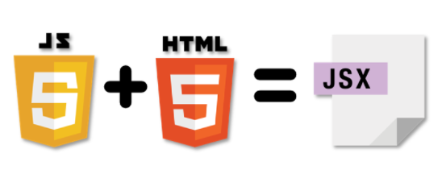
What is JSX?
JSX stands for JavaScript XML.
JSX allows us to write HTML in React. JSX makes it easier to write and add HTML in React.
Npx : Behind the screen Transformed code.
JSX is much faster than normal JavaScript (Optimizations).

Slide 3
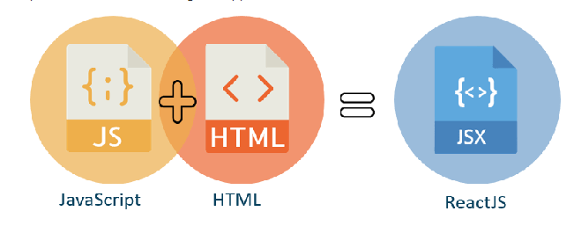
Characteristics of JSX
JSX is not mandatory to use there are other ways to achieve the same thing.
JSX allows writing expression in { }.
To insert a large block of HTML we must write it in a parenthesis i.e., ().
JSX produces react elements.
JSX follows XML rule.

Slide 4

Advantages of JSX
1. JSX makes it easier to write or add HTML in React.
2. JSX can easily convert HTML tags to react elements.
3. It is faster than regular JavaScript.
4. JSX prevents XSS (cross-site-scripting) attacks popularly known as injection attacks.
5. It is type-safe, and most of the errors can be found at compilation time.

Slide 5
Disadvantages of JSX
1. JSX throws an error if the HTML is not correct.
2. In JSX HTML code must be wrapped in one top-level element otherwise it will give an error.
3. If HTML elements are not properly closed JSX will give an error.
“The mix of HTML and JavaScript in JSX makes React JS much more complicated to learn and that may be unappealing to aspiring developers”.

